Slide 1
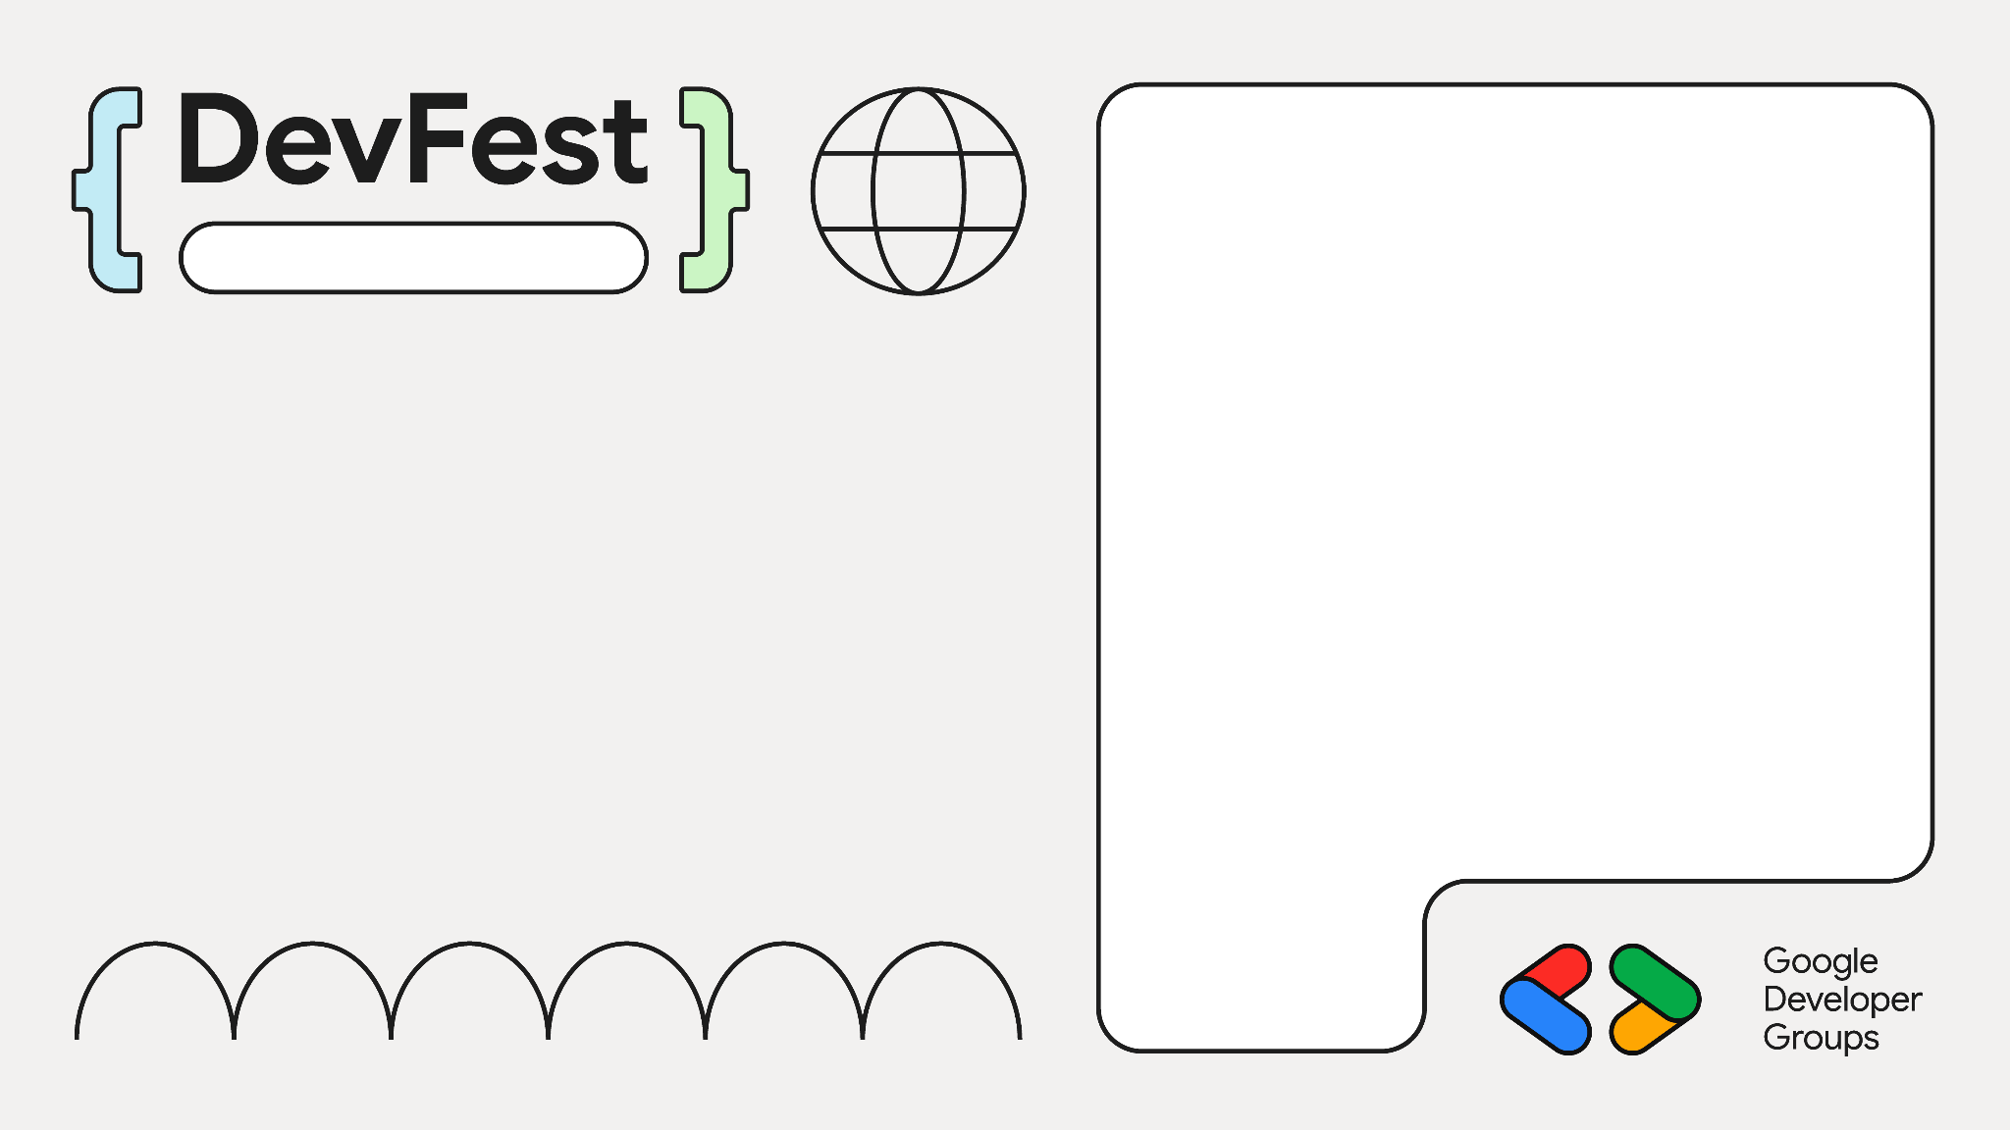

It Starts with a Stock Bot: An Agentic AI Design Pattern for Scalable AI Workflows
Dubai, UAE
Rohan Mitra
ML Engineer @Bayut | Dubizzle
Research Assistant for ML @ AUS
Organizer & Speaker GDG Sharjah

Slide 2
Case Study – G-Stock Brokers
You are an AI Engineer at G-Stock Brokers
The traders want to quickly know how a certain stock is performing in a given time period
They want some market research on latest news + numerical backing
They should be able to ask for a given stock and receive a report with relevant info and suggestions
Let's build an AI workflow with Agent Development Kit!
(And how you can adapt this to your own projects)

Slide 3
Stock Market Analysis Bot
Take a particular stock and time period, and conduct analysis on how the stock performed
Search the web for headlines about the stock
Analyze the market sentiment towards the stock
Fetch and analyze temporal data (prices & volume of the stock) in that time period
Collate data, summarize, and identify actionable insights
Make an organized report

Slide 4
Adaptable Design – Other Use Cases
Weekly sales reports
Daily operations status reports
Chatting with your data
Strategic planning
Generating insights from various data sources

Slide 5
ADK Agents
LLM Agent
Workflow Agent
Sequential Agent
Parallel Agent
Input
Prompt
Input
Input
Sub-Agent 1
Sub-Agent 1
Sub-Agent 2
…
LLM
Sub-Agent 2
Output
…
Output_Key1
Output_Key2
Output

Slide 6
Our Architecture
Parallel Agent
News Agent
Google Search
Data Retrieval Agent
Sequential Agent
Tool Call
Interface Agent
Workflow Agent
API Agent
Fetch Stock Data
Tool Call
Analyzer & Summarizer Agent
Artifact Service

Slide 7
Interface Agent
Interacts with the user
Ask the user for a stock (ticker or name of publicly listed company)
Ask the user for a date range
Validate inputs
Initiate workflow
Return result to user as message

Slide 8
Our Architecture
Parallel Agent
News Agent
Google Search
Data Retrieval Agent
Sequential Agent
Tool Call
Interface Agent
Workflow Agent
API Agent
Fetch Stock Data
Tool Call
Analyzer & Summarizer Agent
Artifact Service

Slide 9
Workflow Agent
Sequential agent
Input text from the Interface agent
First execute Data Retriever Agent (result stored in output_key)
Then execute Analyzer & Summarizer Agent (result stored in output_key)
Once done, return control to Interface agent
Eg: “Analyze GOOG stock performance, news sentiment, technical indicators, and provide trading recommendations for the period 2025-08-01 to 2025-08-31.”

Slide 10
Our Architecture
Parallel Agent
News Agent
Google Search
Data Retrieval Agent
Sequential Agent
Tool Call
Interface Agent
Workflow Agent
API Agent
Fetch Stock Data
Tool Call
Analyzer & Summarizer Agent
Artifact Service

Slide 11
Data Retrieval Agent
Parallel agent
Execute News Agent
Execute API Agent
Once done, return control to Workflow agent

Slide 12
Our Architecture
Parallel Agent
News Agent
Google Search
Data Retrieval Agent
Sequential Agent
Tool Call
Interface Agent
Workflow Agent
API Agent
Fetch Stock Data
Tool Call
Analyzer & Summarizer Agent
Artifact Service

Slide 13
News Agent
Performs several Google searches with different search keys – Google Search tool call
Identifies:
Saves the results in JSON format in an output key “news_agent_output”
Summary of latest news articles & developments of given stock
Top 5 most impactful headlines
Market sentiment (Positive, Neutral, Negative)

Slide 14
Our Architecture
Parallel Agent
News Agent
Google Search
Data Retrieval Agent
Sequential Agent
Tool Call
Interface Agent
Workflow Agent
API Agent
Fetch Stock Data
Tool Call
Analyzer & Summarizer Agent
Artifact Service

Slide 15
API Agent
Uses a tool-call to fetch data for stock from Yahoo finance API (yfinance)
Downloads the open/close/high/low/volume data (as dataframe) for each date
Saves the data as a JSON in artifact service
Artifact: Any large object that is loaded/created
Includes files, images, data, etc
Artifact service: A temporary storage space for the session
Easy way to transfer large objects between agents
Saves to RAM / GCS / Redis

Slide 16
Our Architecture
Parallel Agent
News Agent
Google Search
Data Retrieval Agent
Sequential Agent
Tool Call
Interface Agent
Workflow Agent
API Agent
Fetch Stock Data
Tool Call
Analyzer & Summarizer Agent
Artifact Service

Slide 17
Analyzer & Summarizer Agent
Analyze news data (news_agent_output)
Load and analyze temporal data
Combined analysis
Return summary of analysis to Workflow Agent
Load the data from artifacts
Correlation, timing of news vs stock prices, market reactions to different types of news
News, Trends, Combined Insights, Trading Recommendations, Tables

Slide 18
Our Architecture
Parallel Agent
News Agent
Google Search
Data Retrieval Agent
Sequential Agent
Tool Call
Interface Agent
Workflow Agent
API Agent
Fetch Stock Data
Tool Call
Analyzer & Summarizer Agent
Artifact Service

Slide 19

Adapt To Your Use Case
ADK forces modular architectures
Plug-and-play
Update Prompts
Add / Replace tools & agents
Github repo with code

Slide 20
Our Architecture
Parallel Agent
News Agent
Google Search
Data Retrieval Agent
Sequential Agent
Tool Call
Interface Agent
Workflow Agent
API Agent
Fetch Stock Data
Tool Call
Analyzer & Summarizer Agent
Artifact Service

Slide 21
Your Architecture
Parallel Agent
Your Data Fetchers
API Calls
DB Query
Document Loader
Google Search
Data Retrieval Agent
Sequential Agent
Interface Agent
Workflow Agent
Analyzer & Summarizer Agent
Artifact Service

Slide 22
Your Architecture
Parallel Agent
Your Data Fetchers
API Calls
DB Query
Document Loader
Google Search
Data Retrieval Agent
Sequential Agent
Interface Agent
Workflow Agent
Analyzer & Summarizer Agent
Your Tools
Artifact Service
Graph/Chart Creator
Code Execution
Get ML Model Predictions

Slide 23
Your Architecture
Parallel Agent
Your Data Fetchers
API Calls
DB Query
Document Loader
Google Search
Data Retrieval Agent
Sequential Agent
Interface Agent
Workflow Agent
Your Interaction Method
Generate PDF
Send Email
Send Slack Alert
Reply back in chat
Analyzer & Summarizer Agent
Your Tools
Artifact Service
Graph/Chart Creator
Code Execution
Get ML Model Predictions

Slide 24

Deployment
Deploy directly to GCP – Cloud Run
Non-GCP deployments – Docker container
Identify good Artifact services
Serverless deployments
Single service
Host as `adk api_server –port 8000`
RAM – local / low traffic / single deployment
GCS good for GCP deployments
Redis sidecar for kubernetes deployments
Event driven
Scalable (to 0 if needed)
Medium.com Article

Slide 25
Demo Code on Github
Dubai, UAE

Slide 26




Dubai
Thank You!
https://www.linkedin.com/in/rohan-mitra14/
https://github.com/ro1406
scholar.google.com/citations?user=Jh0DuX4AAAAJ
https://medium.com/@rohanmitra8

